Slide 1

STRESSMETER

Slide 2

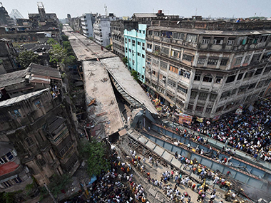
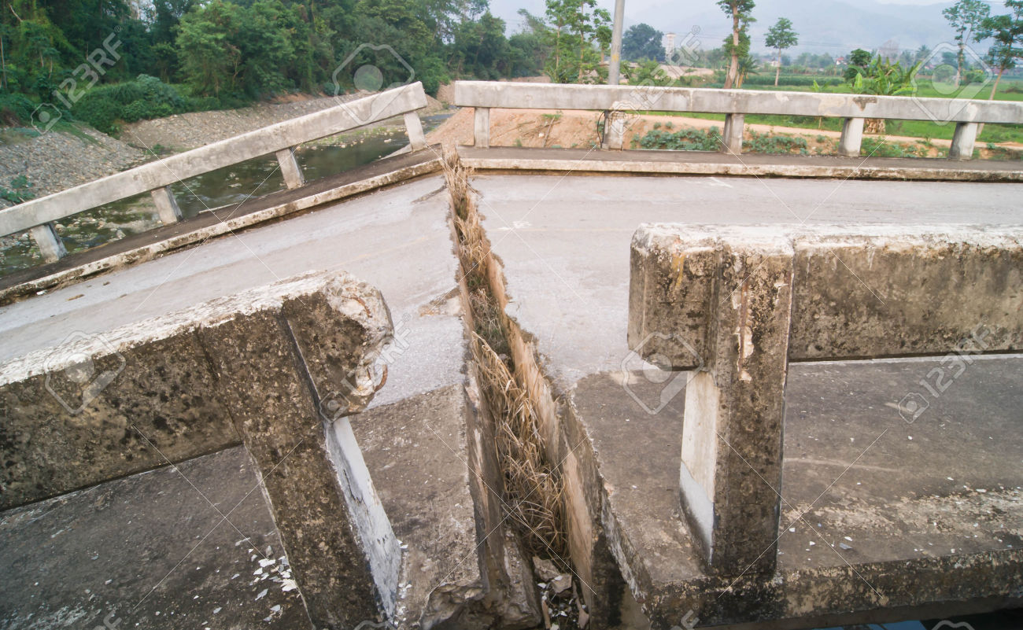
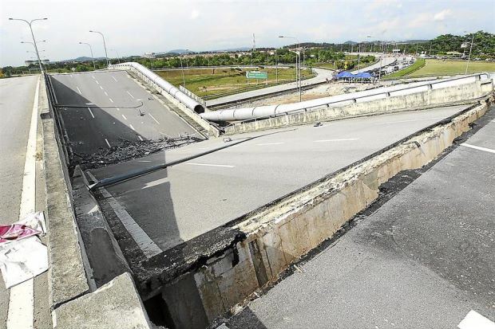

Slide 3
https://www.youtube.com/watch?v=hjqivSXZJhk

Slide 4
Solution Analysis:
24/7 monitoring
Realtime system
Stress analysis
Warning system
Low cost solution
Easy to install

Slide 5
Sense it before it happens
STRESSMETER

Slide 6
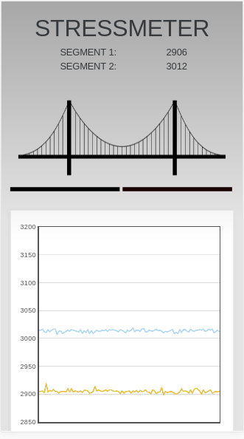
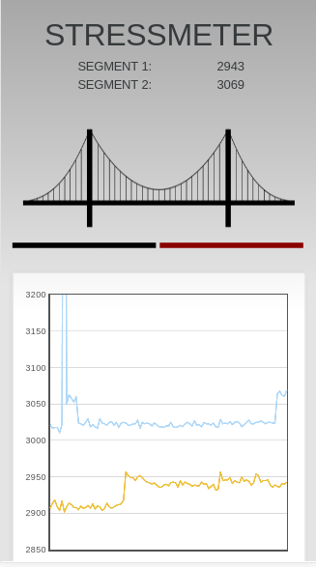

Slide 7
Expansions:
Large Scale:
Buildings
Dams
Assist in the detection of pre-earthquake waves
Small Scale:
Furniture
Could be used for data analysis for implementing better structures.

Slide 8
Questions?

Slide 9
Thank You

